Slide 1
Millennium High School Agenda Calendar
9/6/16
Objectives: Understand that the tangent & velocity problems are basic to calculus.
Section 2.1 The Tangent & Velocity Problems WU: #6 CW: 2.1 Review HW: WebAssign (#14) ☺☻
CA Standards: Calculus
“Don’t limit your challenges. Challenge your limits”
-Anonymous

Slide 2
Calculus
9/6/16
Warm-Up #6
Find an equation of the line that satisfies the given conditions:
through (1, 7) and parallel to the line passing through (2, 5) and (-2, 1).
Write in slope-intercept form.
Rewrite the quadratic function into vertex form: $f\left(x\right)=x^{2}+2x−1$
Find a function whose graph is a parabola with vertex (1, -5) and that
passes through the point (2, -3).

Slide 3
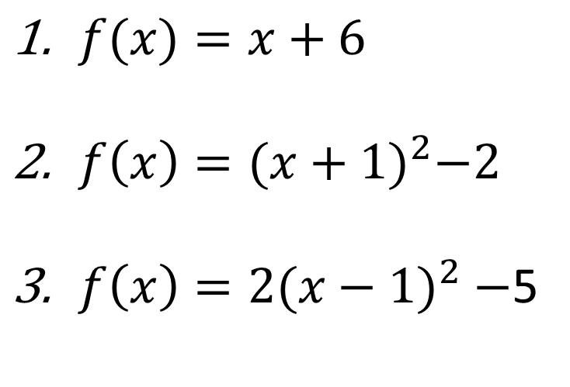
$f(x)=x+6$
$f\left(x\right)={(x+1)}^{2}−2$
$f\left(x\right)={2(x−1)}^{2}−$5

