Slide 1
Millennium High School Agenda Calendar
9/12/16
Objectives: Use the properties of limits to solve problems.
Section 2.3 The Laws of Limits WU: #7 CW: 2.3 Notes HW: WebAssign (#17) Get grade reports signed! ☺☻
CA Standards: Calculus
“You can’t have a million dollar dream with a minimum wage work ethic. ”
-Anonymous

Slide 2
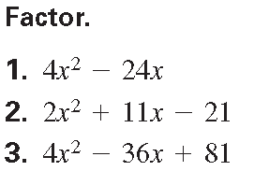
Calculus
9/12/16
Warm-Up #7

