Slide 1
Millennium High School Agenda Calendar
8/8/16
Objectives: Simplify problems involving functions.
Section 1.1 4 Ways to Represent a Function WU: #2 CW: 1.1 Notes & Exit Ticket #1 HW: WebAssign Assignment 1 (#1) ☺☻
CA Standards: Calculus
“Common sense is like deodorant. The people who need it most never use it.”
-- Anonymous

Slide 2
Calculus
8/8/16
Warm-Up #2
Evaluate each expression without using a calculator.
1. ${(−3)}^{4}$ 2. ${−3}^{4}$ 3. $3^{−4}$
4. $\frac{5^{23}}{5^{21}}$ 5. ${\left(\frac{2}{3}\right)}^{−2}$ 6. ${16}^{−3/4}$

Slide 3
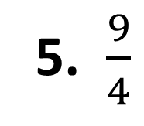
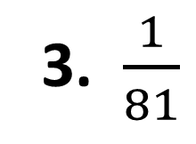
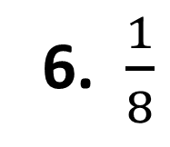
1. 81
2. -81
3. $\frac{1}{81}$
4. 25
5. $\frac{9}{4}$
6. $\frac{1}{8}$

