Slide 1
Millennium High School Agenda Calendar
8/26/16
Objectives: Pass the Quiz!
1.5-1.6 QUIZ Good luck!!! WU: None CW: 1.5-1.6 Quiz HW: Get grade reports signed! ☺☻
CA Standards: Calculus
“What you do today can improve all your tomorrows.”
-- Ralph Marston

Slide 2
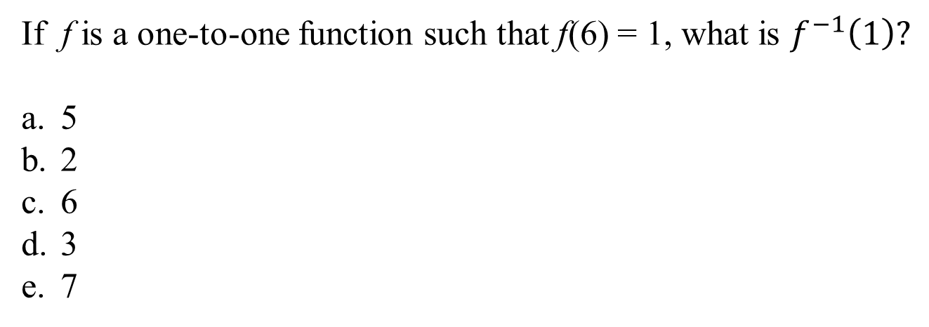
Replacement Problem
Quiz A: 17
Quiz B: 17
Quiz C: 2
If f is a one-to-one function such that f(6) = 1, what is $f^{−1}\left(1\right)?$
5
2
6
3
7

