Slide 1
Millennium High School Agenda Calendar
8/15/16
Objectives: Transform functions into new functions & do function compositions.
Section 1.3 New Functions from Old Ones WU: #3 CW: 1.3 Notes HW: WebAssign (#5) ☺☻
CA Standards: Calculus
“If at first you don’t succeed, you’re like everyone else who went on to greatness.”
--Patrick Combs

Slide 2
Calculus
8/15/16
Warm-Up #3
Rewrite by completing the square.
1. $x^{2}+x+1$ 2. ${2x}^{2}−12x+11$

Slide 3
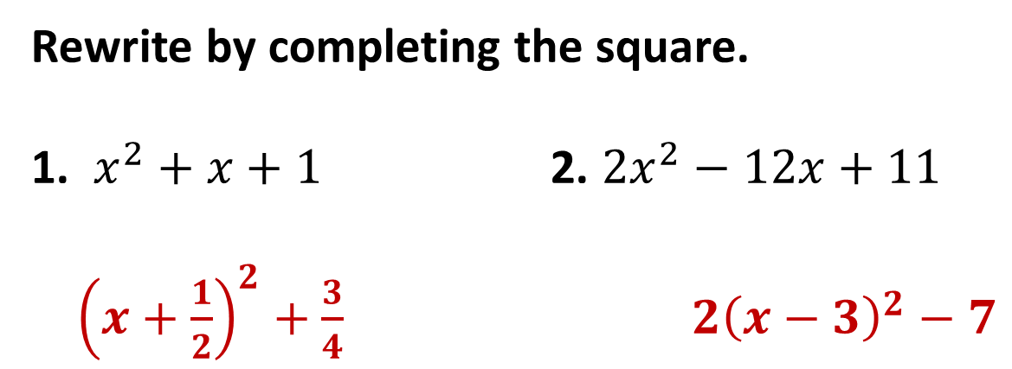
Rewrite by completing the square.
1. $x^{2}+x+1$ 2. ${2x}^{2}−12x+11$
${\left(x+\frac{1}{2}\right)}^{2}+\frac{3}{4}$ ${2\left(x−3\right)}^{2}−7$

